Slide 1
Concepts Foundation
Data vs. Information
Data Storage Models
RDF and SPARQL
Wikidata

Slide 2
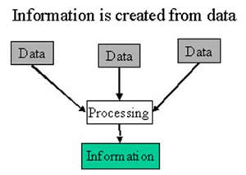
Data vs. Information

Slide 3
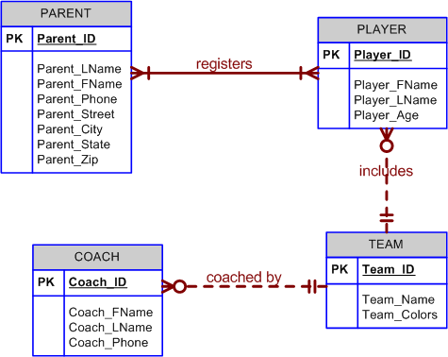
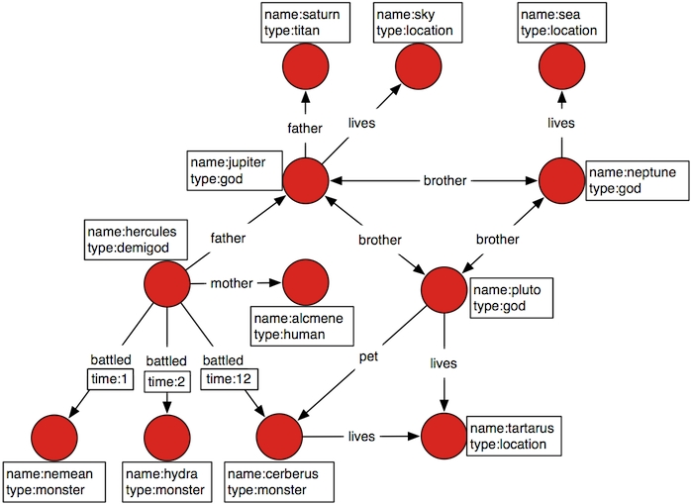
Data Storage Models
Relational Data Tables vs Semantic Data
Tables vs triplets

Slide 4
RDF and SPARQL
Resource Description Framework
Simple Protocol and RDF Query Language

Slide 5
WIKIDATA

Slide 6
What is a Wiki-thing?
A wiki is a website on which users collaboratively modify content and structure directly from the web browser.

Slide 7
What is WikiData
Wikidata is a collaboratively edited knowledge base hosted by the Wikimedia Foundation. It is intended to provide a common source of open data .

